Slide 1
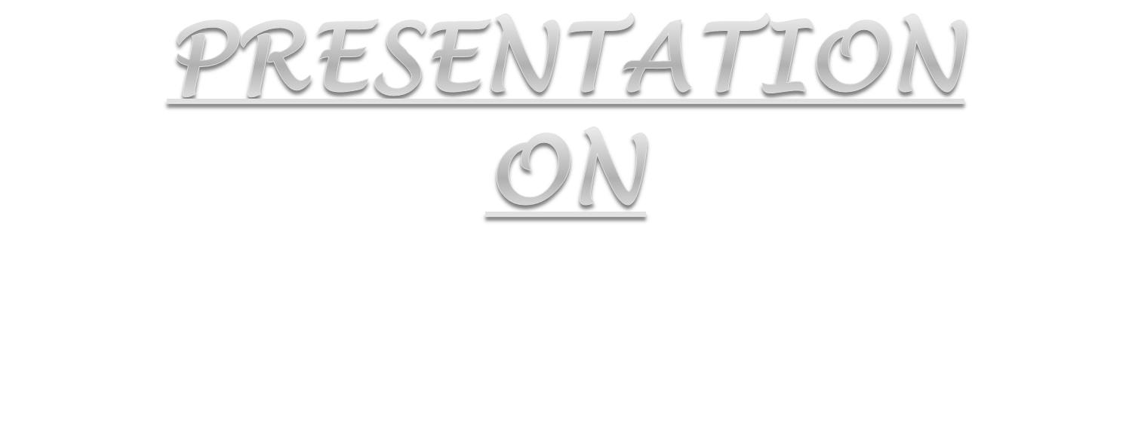

Body Language, Interview Skills, Business Etiquettes

Slide 2


Slide 3

Body language is a form of mental and physical ability of human non-verbal communication
body posture, gestures, facial expressions, and eye movements
Body language, or nonverbal communication, can let interviewers know more about you than what you tell them.

Slide 4
Body Position - the location of the arms, legs and hands as well as the manner of sitting or standing can tell you a lot
Eye Contact - eyes can reveal moods and feelings as well as intentions and interest.
Facial Expressions - our expressions also send a message.

Slide 5
Physical Appearance - the manner in which one dresses tells a little about his or her personality and character. In addition, the items a person carries by choice can also aid in determining personality traits.
Touch (handshake) - the manner in which one person touches another can reveal a great deal about his or her character.
A firm handshake often hints of a strong-willed and straight forward individual.
Space - the distance a person keeps while talking is a good indication of his or her openness and sociability. We all have a .comfort space. that we like to keep around us.

Slide 6
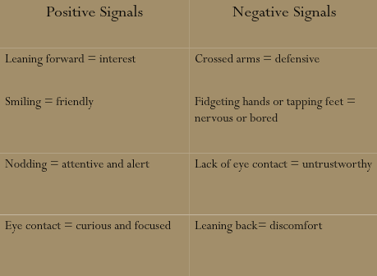

Slide 7

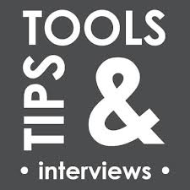

Slide 8
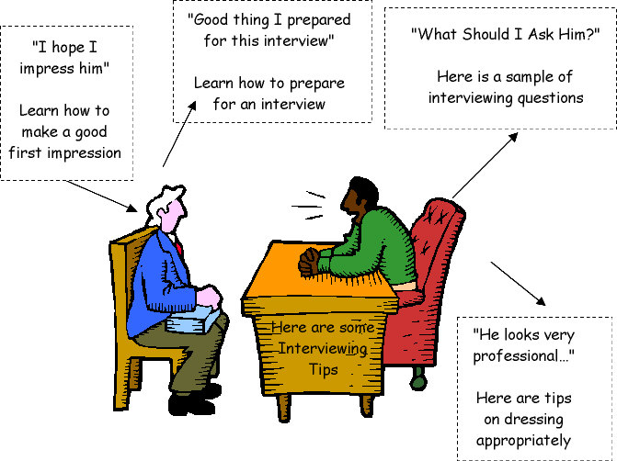
Interview Skills
Before the interview
Creating a good first impression
During the interview

Slide 9
Before the Interview
Do your homework
Prepare yourself with interview-related information
Prepare yourself to feel stress-free
Organize yourself

Slide 10
Creating Good 1st Impression
Be there on time
Put your mobile phone on silent or cut it off
Smile
Be confident
Posture and body language
Accessories

Slide 11
During Interview
Wait to be asked to sit, and where to sit.
Offer to shake hands only if the interviewer extends the offer first.
Do not fidget with your mobile phone, accessories or other gadgets during the interview.
Be concise in what you say. When you are asked a question, a clear and honest answer is expected of you.
Be honest. Honesty pays, and it shows.

Slide 12
During Interview (Cont.)
Be prepare with examples to back up what you say. This could relate to qualities you have, work you have done or values that you hold dear. Let the examples be simple and clear.
Keep your guard up, through. Sometimes in our effort to be honest we say too much, or say things that might work against. Be both honest and wise.

Slide 13
Business Etiquette
What is Business Etiquette - rules and conventions governing correct or polite behaviour used in society, in a particular social or professional group setting

Slide 14
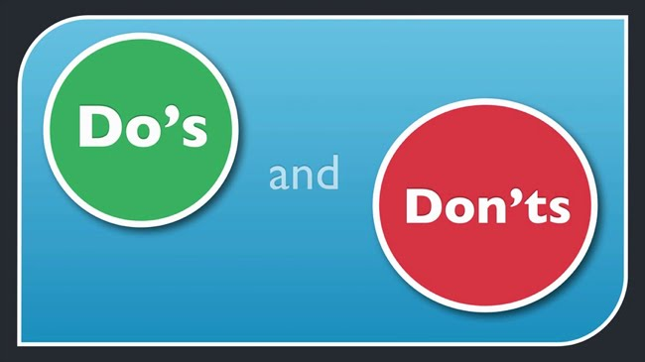
Some Do’s and Don’t
Smile, smiling will project a positive image to the listener and will change the tone of your voice
Speak slowly and clearly
Use the person’s title (Mr. or Ms. And their last name.) Only use the first name if they ask you to
Don’t interrupt the interviewer
Take your time…it’s perfectly acceptable to take a moment or two to collect your thoughts, Give short answer
Remember your goal is to set-up a face-to-face interview. After you think the interviewer ask if it would be possible to meet in person

Slide 15
